Slide 1

How to train your Pandas
Ilias Xenogiannis
Ioannis Karakasis

Slide 2
How to train your Pandas
Motivation

Slide 3




Pandas Birth-Certificate
2009
AQR Capital Management
Father
Wes Mckinney
Data Science
Experimental Sciences
BSc in Mathematics
(MIT,2006)
Economics
"Apache Arrow"

Slide 4
Pandas Little Secrets
Improved tool for visualizing data
Efficient Coding
Powerful package
[Great Variety of commands, Analysing, Filtering & Managing large datasets]
Steep learning curve
3-D Matrices Compatibility

Slide 5
Pandas Data Structures
1-D
2-D
Pandas Dataframes
Pandas
Series
(list, dict)
(np.array,list, dict)

Slide 6
How to train your Pandas
Importing Data

Slide 7

Importing Data
.csv files
import pandas as pd
data1 = pd.read_csv('filename.csv')
data2 = pd.read_csv(url)
.txt files
file = open('filename.txt', mode='r')
text=file.read()
text=file.close()
Excel files
import pandas as pd
data = pd.ExcelFile('filename.xlsx')

Slide 8

Importing Data
.json files
import json
with open('filename.json', 'r') as json_file:
json_data=json.load(json_file)
[type of json_data: dictionary]
Other files
MATLAB files
Stata files
SAS files
Pickled files

Slide 9
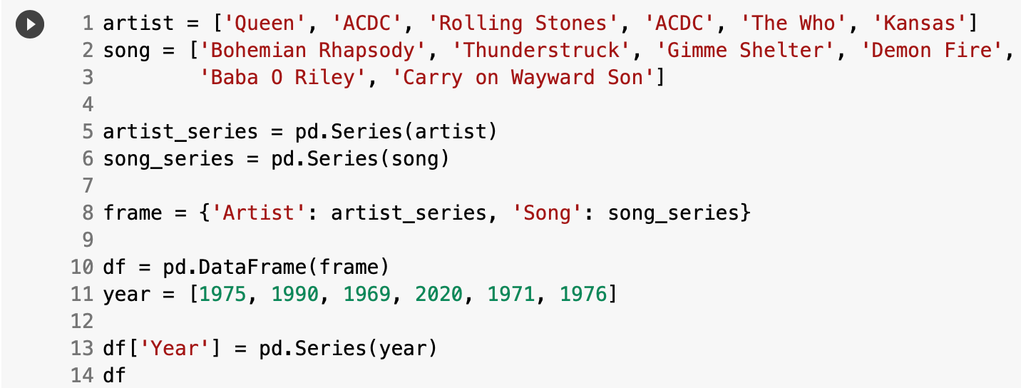
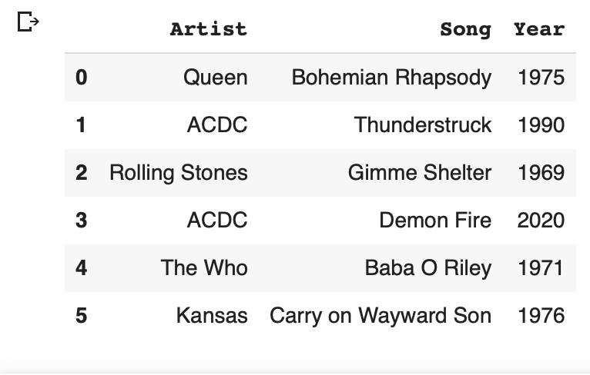
Dataset

Slide 10

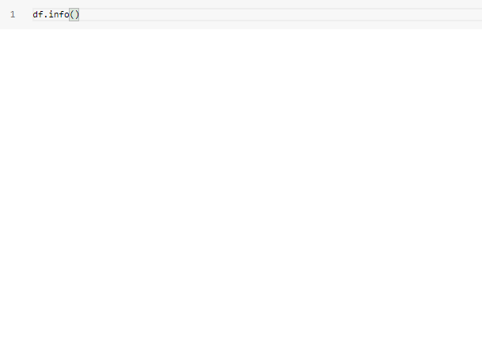
Getting to know your Dataset
df.columns
list of column names
df.info()
Summary of datsaset
df.values()
Array of dataframe's
values

Slide 11
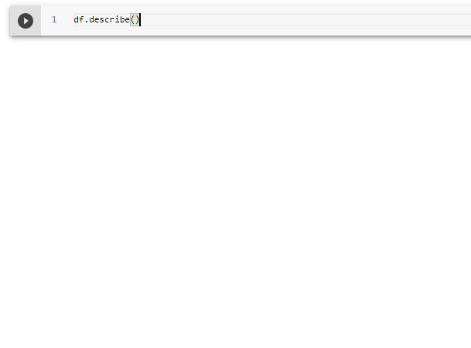
Getting to know your Dataset
df.shape
(rows, columns)=(6, 3)
df.describe()
Dataframe's Statistics
df.index
Range of indexing
(start, step, stop)

Slide 12
How to train your Pandas
Slicing
&
Indexing

Slide 13
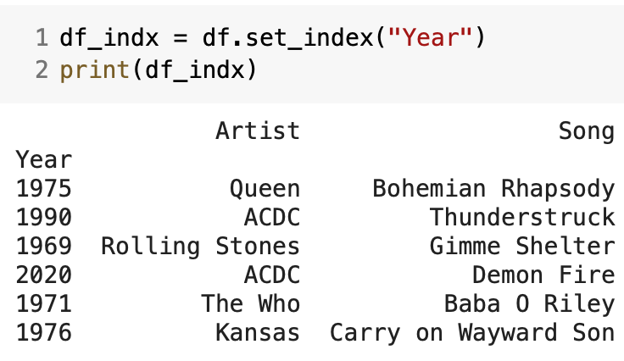
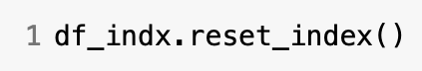
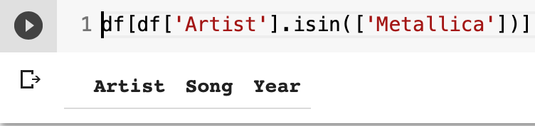
Slicing & Indexing
?
Starting Dataset

Slide 14
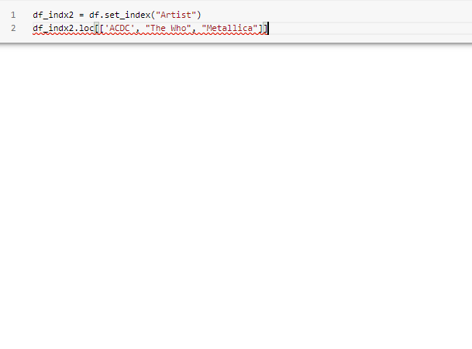
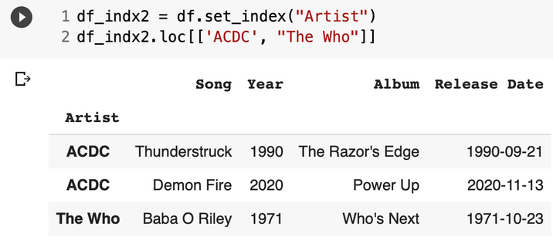
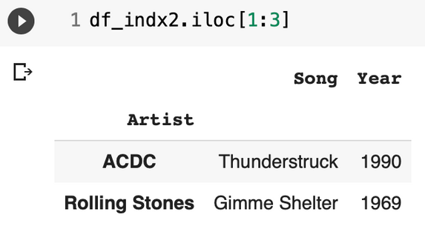
Slicing & Indexing
df_indx.loc[categorical]
displays only the row
of the item in [..]
df_indx.iloc[index range]
displays only the
rows in the given
range

Slide 15
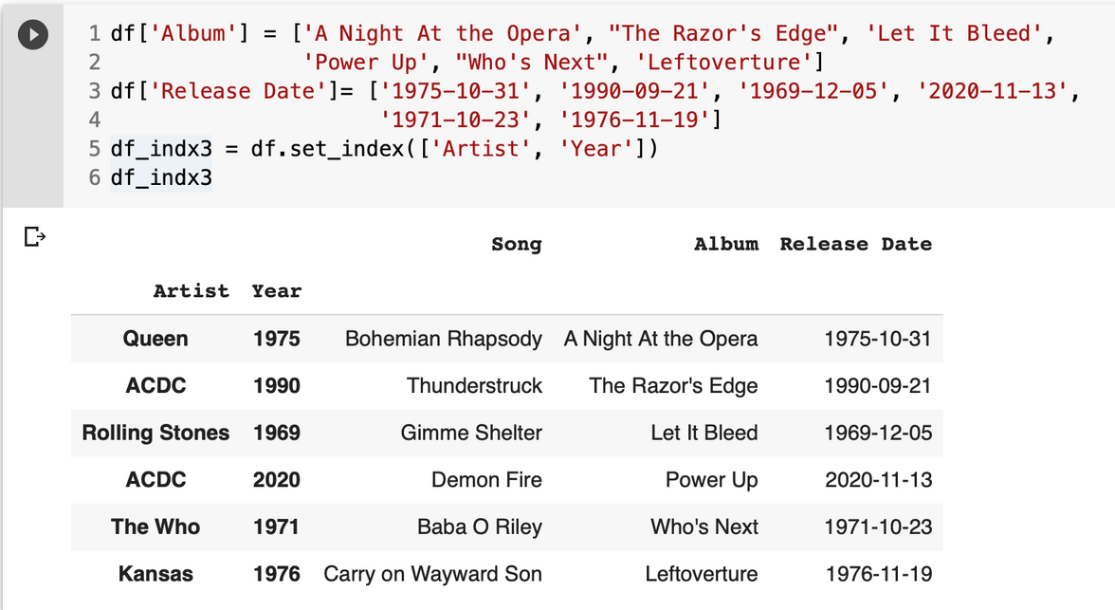
Changed Dataset
Multi-indexing?

Slide 16
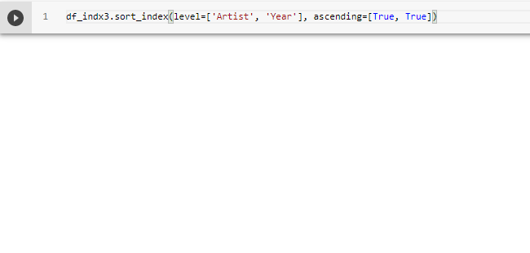
Slicing & Indexing
df.sort_index(level, ascending)
level= [list]
ascending= [list of booleans]
(alphabetically/numerically)

Slide 17
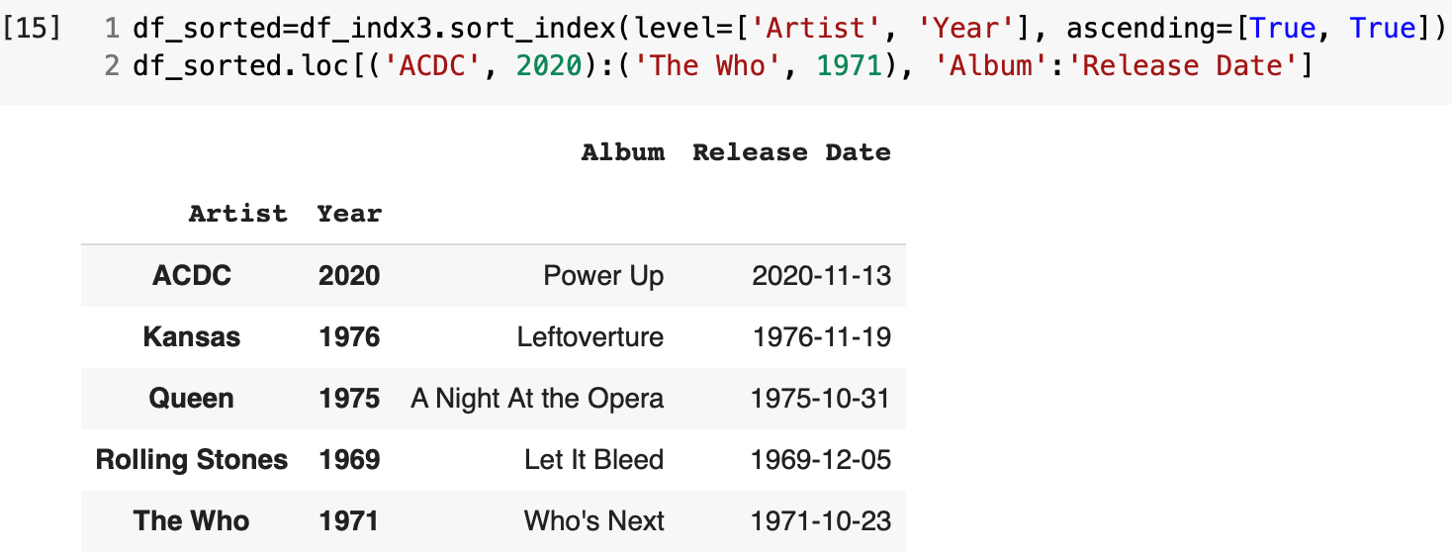
Multi-level Indexing

Slide 18
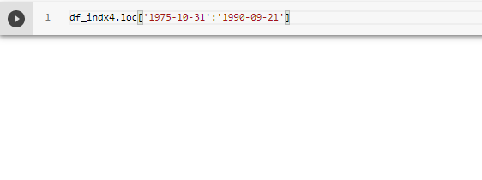
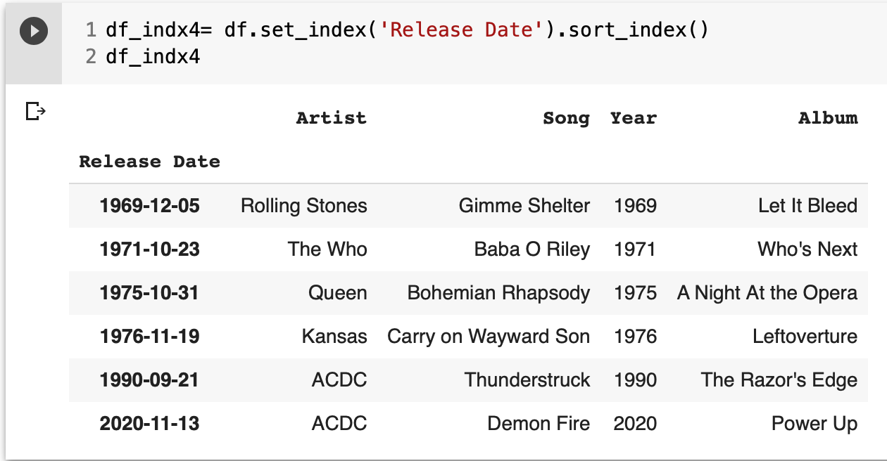
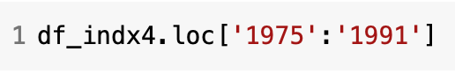
Locating by date
partial locating
(only by year)

Slide 19
How to train your Pandas
Filtering Data

Slide 20
Filtering Data
🎯
is to get to keep only the part of your Dataframe
that you need to find specific answers.
We can achieve that by different techniques using:
lists of objects inside the dataframe
boolean logic (True/False)
strings

Slide 21
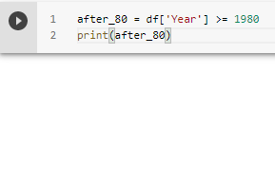
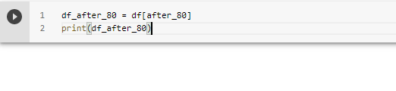
Filtering Data
We need to create a condition that will separate the data.
For this we use symbols:
>=, <=, == , !=
Finally, the data we want are
marked as True.

Slide 22
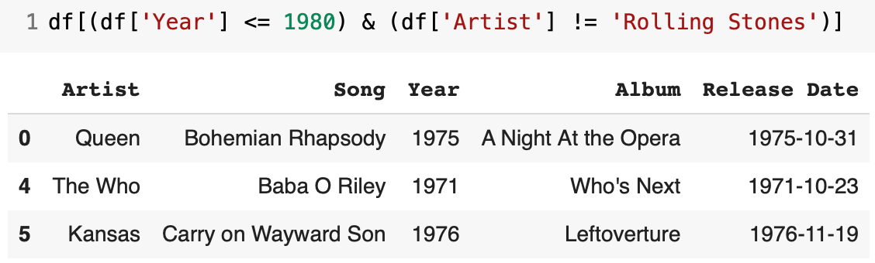
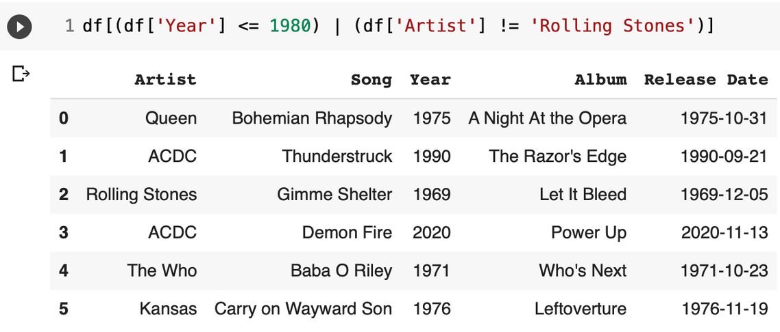
Filtering Data
In case we want to use
multi-conditional states,
we have to use Boolean
logic
(&, |)

Slide 23
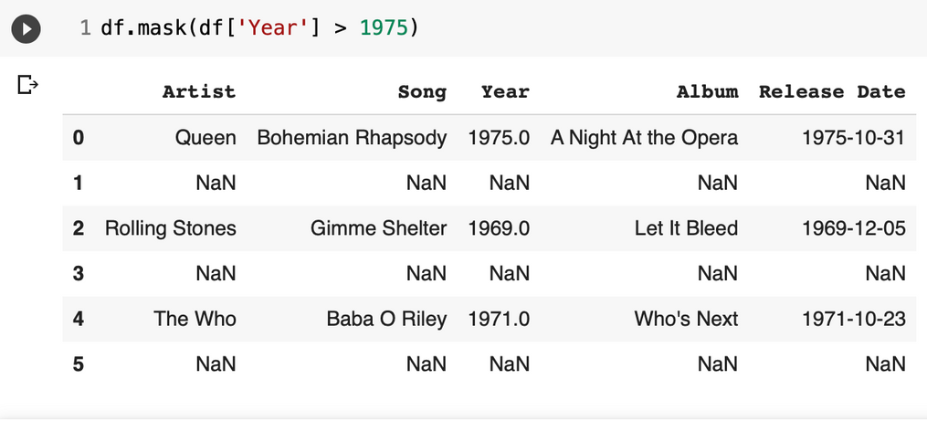
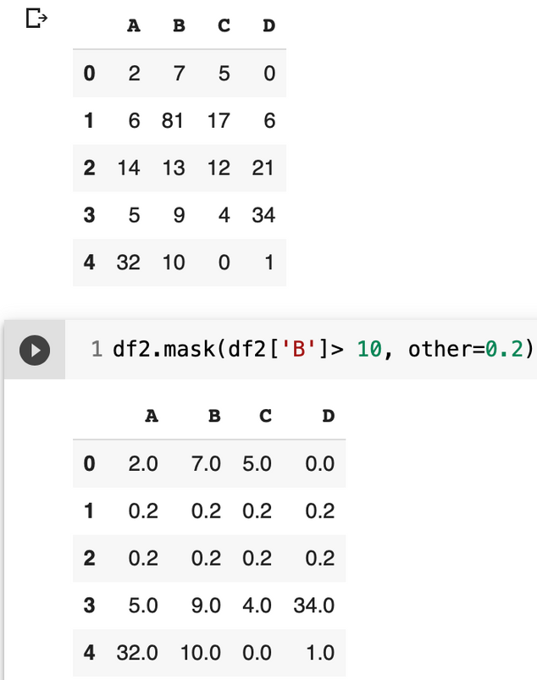
Filtering Data
.mask(cond, other, inplace, axis, ...)
str
cond=condition
other= scalar, df/series,..
inplace=Boolean
(default=False)
axis={0,1}
Replaces values where
condition is True
numerical

Slide 24
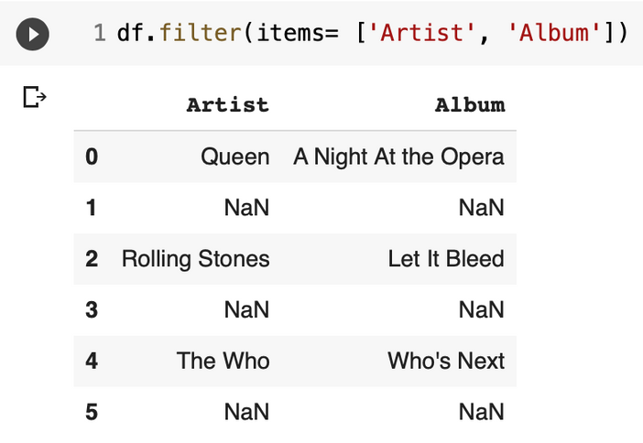
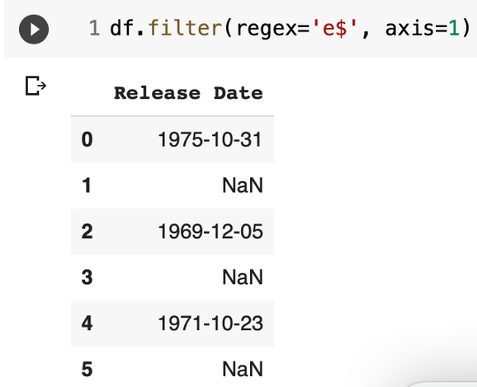
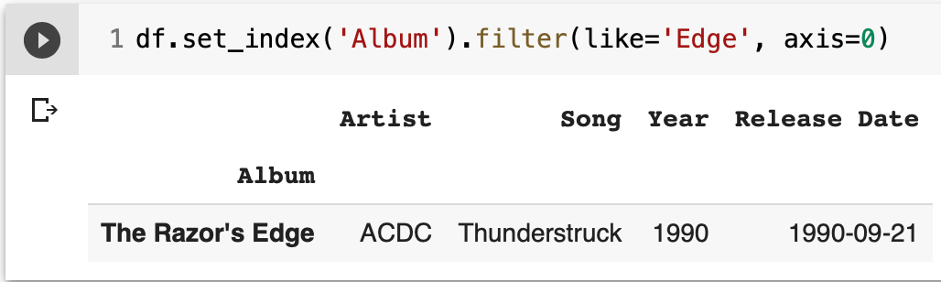
Filtering Data
.filter(items, like,regex, axis)
items = list, like = str
regex = str, axis={0,1}
regex = 'str$'
'^str'

Slide 25
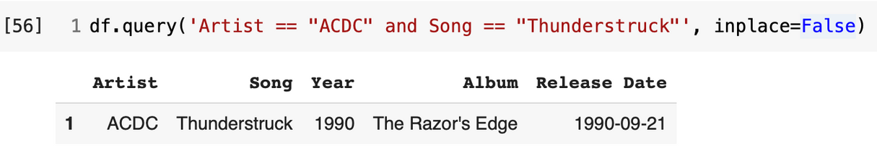
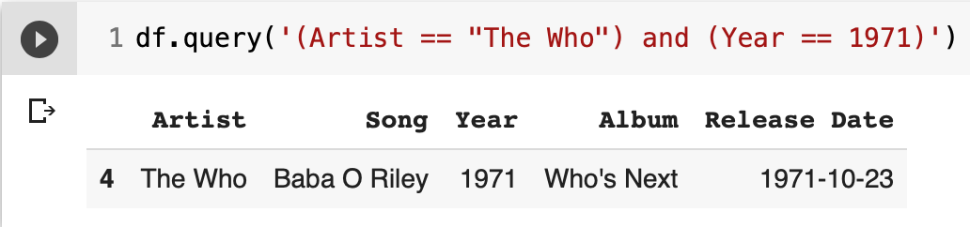
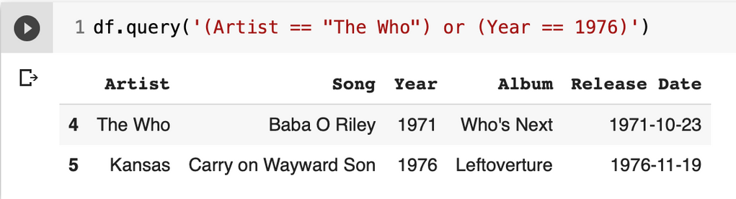
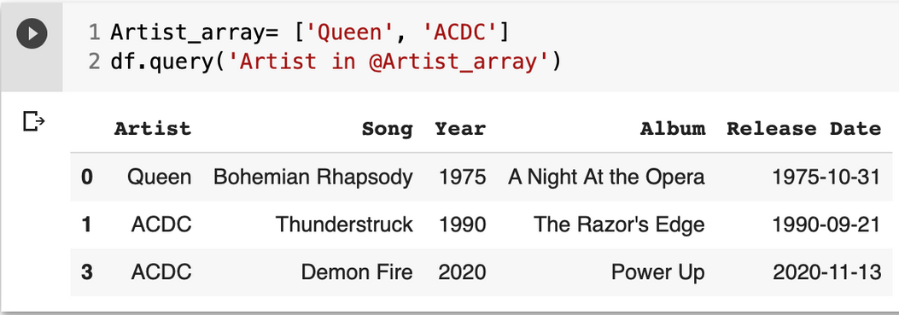
Filtering Data
.query(expr, inplace)
expr = str
inlace = Boolean
checks a boolean
expression between
the columns of the
DataFrame

Slide 26
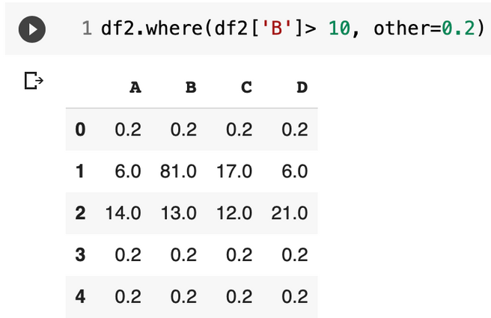
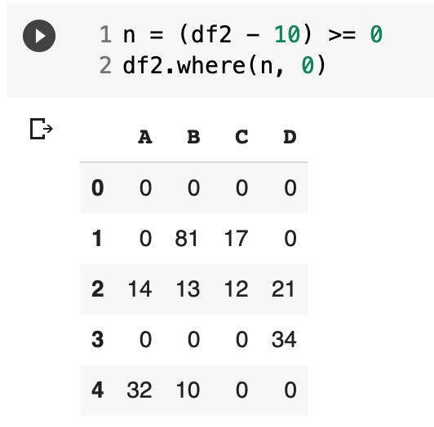
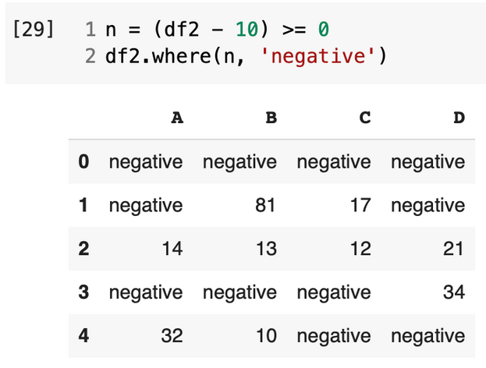
Filtering Data
.where(cond, other, inplace, axis, ..)
cond =bool Series/df, callable, array-like
other= scalar, Series/df, callable
inlace = Boolean
Replaces the values
for a False condition.

Slide 27
How to train your Pandas
Missing Values

Slide 28
Handling Missing Values
⚠️
In real life problems, missing values can affect our analysis.
Missing values = unusable
Drop NaN
Replace NaN

Slide 29
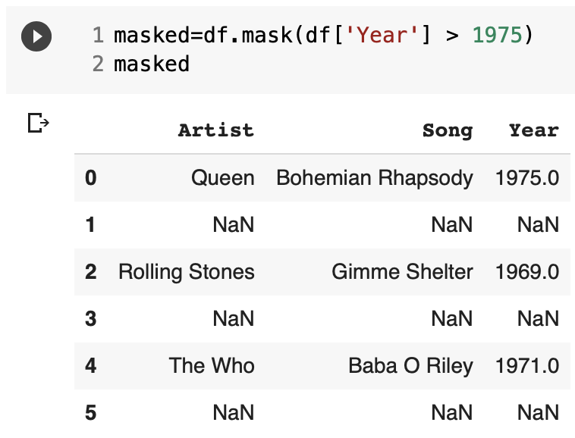
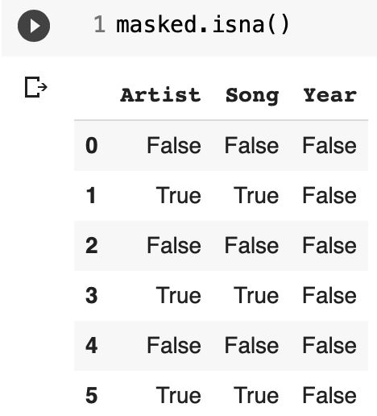
Detecting Missing Values
.isna(obj)
Detects missing values in an array-like object
.notna(obj)
Detects non-missing
values in an array-like
object

Slide 30
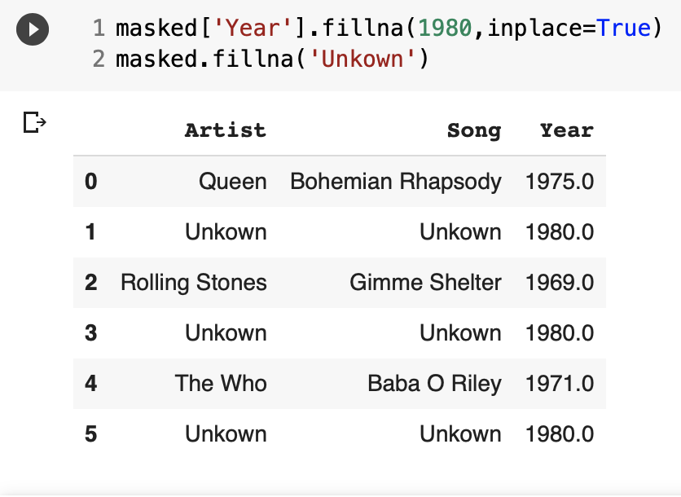
Detecting Missing Values
.fillna(value, method, inplace, axis,..)
method {‘bfill’, ‘ffill’, None}
.dropna(axis, how, thresh, subset,
inplace)
axis ={0,1}, how={any, all},
thresh=int, subset=
array-like

Slide 31
How to train your Pandas
Functions

Slide 32
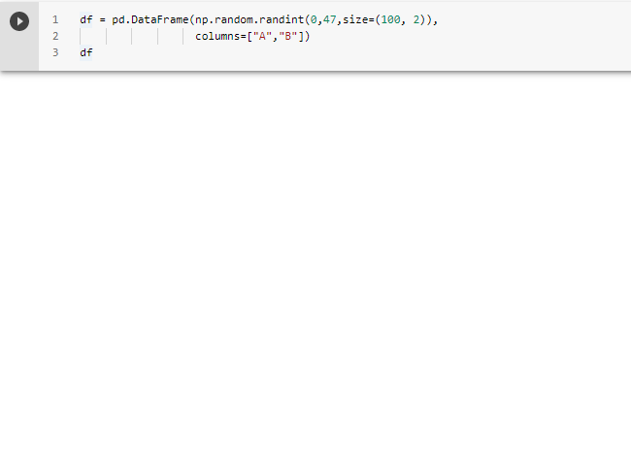
Dataset
Random numerical data
Useful approach for
"stress testing" Pandas
More on that later

Slide 33
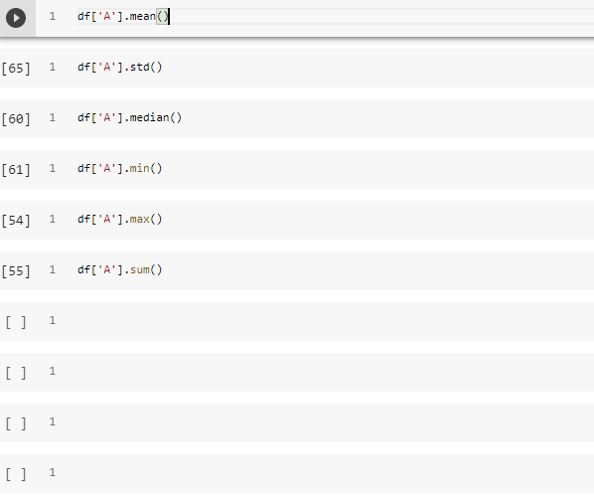
Builtin Functions
Can be applied both on
dataframes and series
Built-in Functions available
for most functionalities
min, max,
sum, median, mean,
std, var, etc.

Slide 34
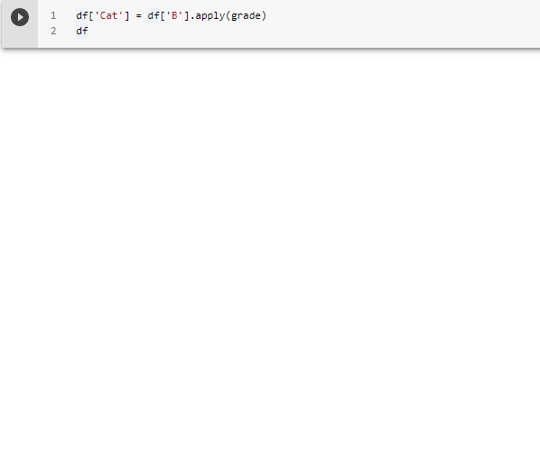
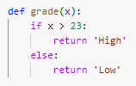
Apply
It is used when you want
to apply a function along
the row or column.
If you must loop, just apply

Slide 35
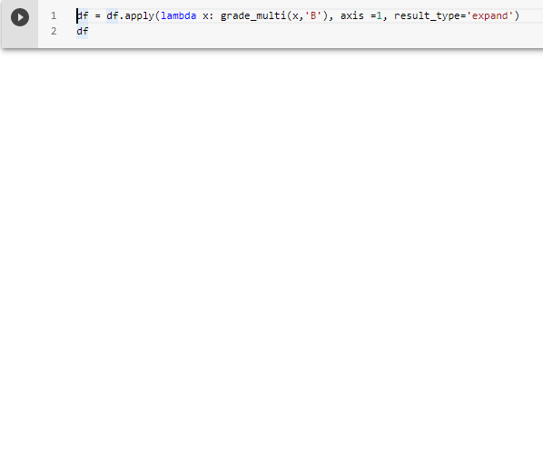
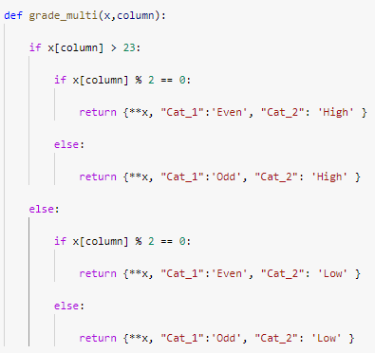
Apply with multi returns
Expand list-like results to
columns of a Dataframe
using expand

Slide 36
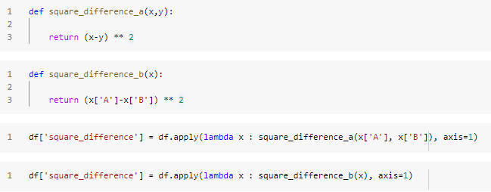
Apply with multi inputs
Different approaches
Same results!

Slide 37

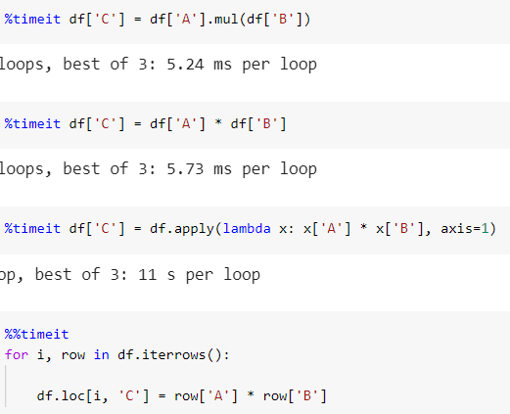
Pandas Speed
Pandas Native
Python Native
This experiment used multiplication,
but can be replicated by other functions
and have the same results
Apply
Iteration

Slide 38
Pandas Speed
Pandas Native function
Python Native function
WANNA GO FASTER?
GO NUMPY
Apply
Iteration
0
2
4
6
ms (log axis)

Slide 39
How to train your Pandas
Aggregating

Slide 40
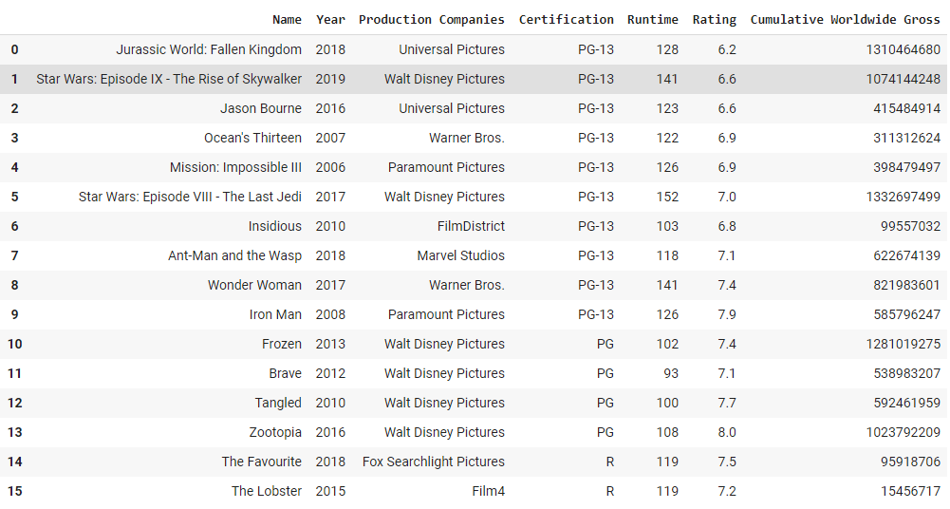
Dataset

Slide 41

Aggregating
Splitting into
groups determined
by "keys"
Split
Applying a
custom function
or one of the
dozens builtin
Apply
Combine
Combining the data
to a single datatype
https://bit.ly/3arUm5F

Slide 42
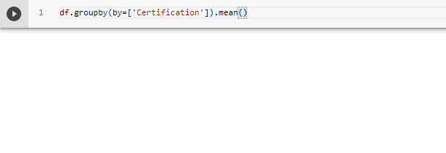
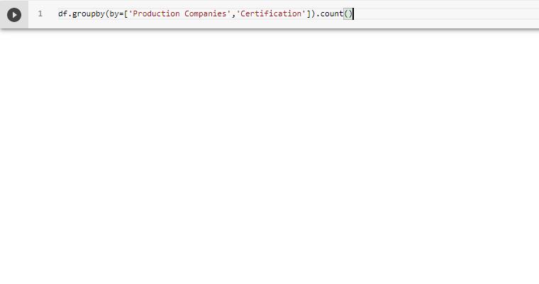
Groupby
Groupby doesn’t perform any operations on the table
Groupby returns DataframeGroupBy
DataframeGroupBy need a function applied to it

Slide 43
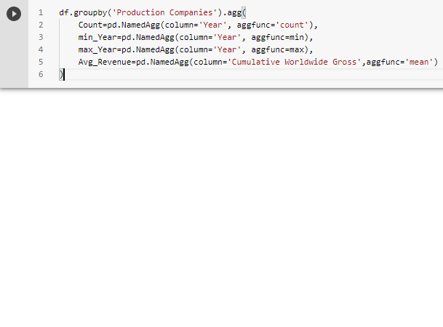
Apply
Column-specific aggregation,
with control over the output
column names
The function names
can also be strings.
Check if a function is implemented
before using apply

Slide 44

Thank you for your Attention!
"Ένα ξέρω, ότι ξέρω τα Pandas "
Socrates the
Panda -2020

Slide 45


ABOUT US
John Karakasis
Ilias Xenogiannis
linkedin.com/in/john-karakasis-157b03175/
linkedin.com/in/ilias-xenogiannis/
medium.com/@ixeno
Github link:
github.com/ilias1111/pandas-introduction-seminar
PANDAS DOCUMENTATION:
https://pandas.pydata.org/docs/

Slide 46

See you at the
Workshop in 10'!
bit.ly/3awAwGm

